Slide 1
NETWORK ANAMOLY DETECTION
BUSINESS CONTEXT:
With the enormous growth of computer networks usage and the huge increase in the number of Applications running on top of it, network security is becoming increasingly more important. All The computer systems suffer from security vulnerabilities which are both technically difficult and economically costly to be solved by the manufacturers. Therefore, the role of Intrusion Detection Systems (IDSs), as special-purpose devices to detect anomalies and attacks in the network, is Becoming more important. The research in the intrusion detection field has been mostly focused on anomaly-based and misuse based detection techniques for a long time. While misuse-based detection is generally favored in commercial products due to its predictability and high accuracy, in academic research anomaly detection is typically conceived as a more powerful method due to its theoretical potential for addressing novel attacks. Conducting a thorough analysis of the recent research trend in anomaly detection, one will encounter several machine learning methods reported to have a very high detection rate of 98% ,While keeping the false alarm rate at 1%. However, when we look at the state of the art IDS Solutions and commercial tools, there is no evidence of using anomaly detection approaches, and Practitioners still think that it is an immature technology. To find the reason of this contrast, lots of research was done done in anomaly detection and considered various aspects such as learning and detection approaches, training data sets, testing data sets, and evaluation methods.
- Arunn Thangavel (475162)

Slide 2
Business problem and Approach :
PROBLEM STATEMENT:
Task is to build network intrusion detection system to detect anomalies and attacks in the
Network. There are two problems.
1. Binomial Classification: Activity is normal or attack
2. Multinomial classification: Activity is normal or DOS or PROBE or R2L or U2R
Approach ( Presenting two models for Binomial and Multinomial each ):
The problem can be handled with classification model, Binary and multinomial classification for Binomial and Multinomial classification respectively.
1. Binary and multiple classifier in Feed Forward Neural Network.
2. Binary and multinomial classifier in Long Short Term Memory Recursive Neural Network.

Slide 3
Analysis
It's a Balanced dataset.
The Data is skewed and is with no null values.
Multicollinearity present between the following variables and others- srv_rerror_rate, srv_serror_rate, dst_host_rerror_rate, dst_host_serror_rate , num_compromised, rerror_rate, serror_rate.
Constant value present in following variables: num_outbound_cmds.
Varieties of Anomaly is not consistent across the datasets ( hence merged then splitted).
Attack field with "mailbomb" value in the data is not categorized in the document ( hence dropped 256 records from the dataset).
"Count" ,"dst_host_srv_serror_rate" , "diff_srv_rate", "dst_host_diff_srv_rate" are highly correlated with the Target field.

Slide 4
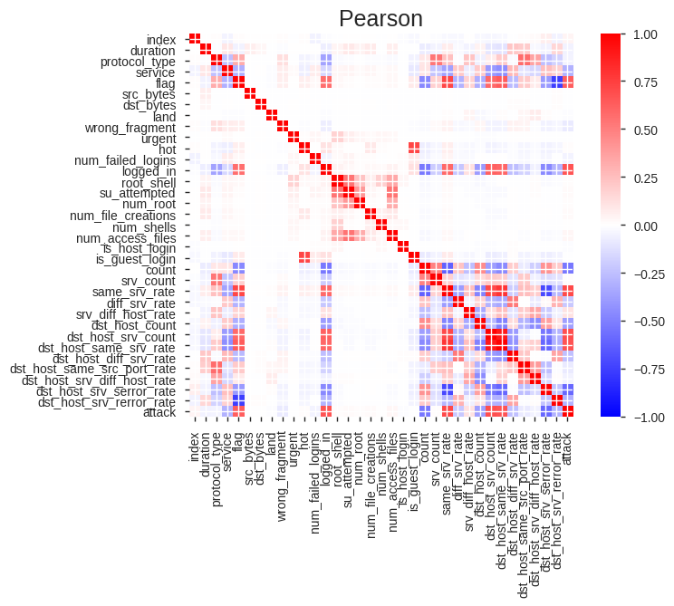
EDA : Pearson – r correlation

Slide 5
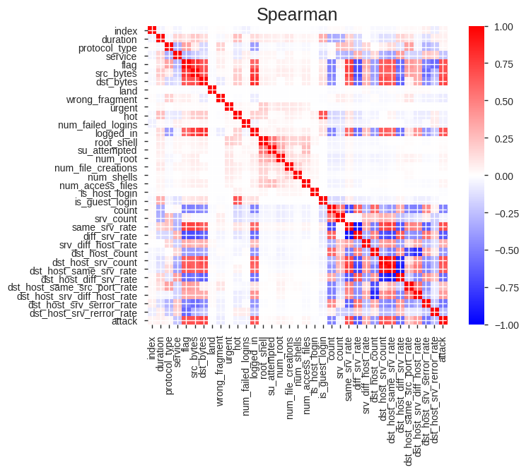
EDA: Spearman correlation

Slide 6
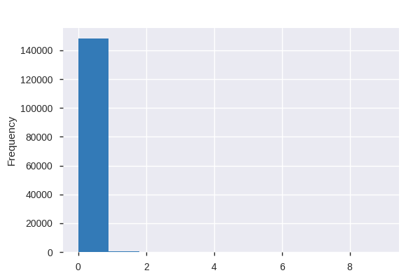
EDA : Skewed data (num_access_files)

Slide 7
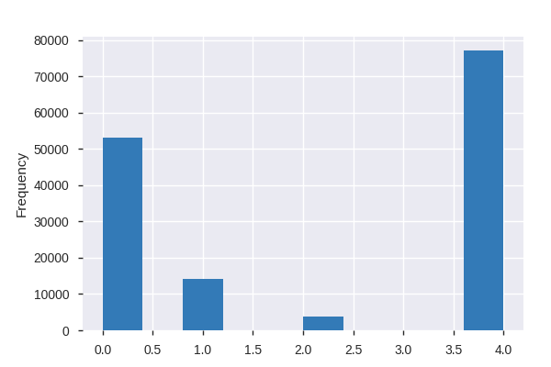
EDA: Distribution Analysis on Attack (Target).

Slide 8
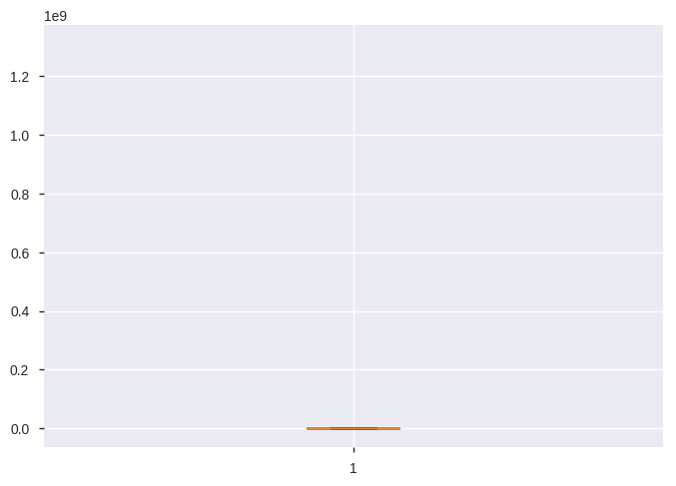
EDA: Boxplot("dst_bytes")

Slide 9
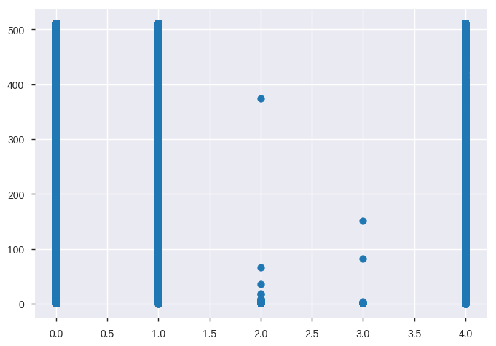
EDA: Scatter plot ("attack")

Slide 10
Actions
Data is cleaned by removing the non contributing fields.
Data is scaled to rectify the skewness.
Attack data is clustered for binomial and multinomial classifications respectively.
Attack field is Target (y) and remaining 34 fields are Predictor fields(X).
Non numeric data is Encoded.
LSTM and FF Neural Networks are built.
The Hyperparameters are tuned for high performance using earlystopping and grid search techniques.
ROC – AUC is used as performance metric to the model and is exported.

Slide 11
Binomial Classification
1. Feed Forward Neural Network:
Accuracy : 99.01%
AUC - ROC: 0.999
2. LSTM:
Accuracy: 99.12%
AUC – ROC : 0.999

Slide 12
Multinomial Classification
1. Feed Forward Neural Network:
Accuracy : 99.49%
AUC - ROC: 1.00
2. LSTM:
Accuracy: 99.53%
AUC – ROC : 1.00

